Slide 2
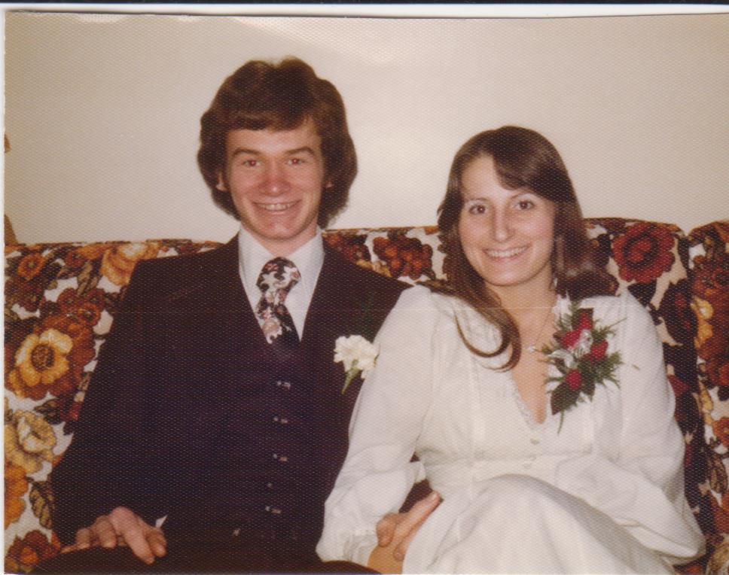

Slide 3
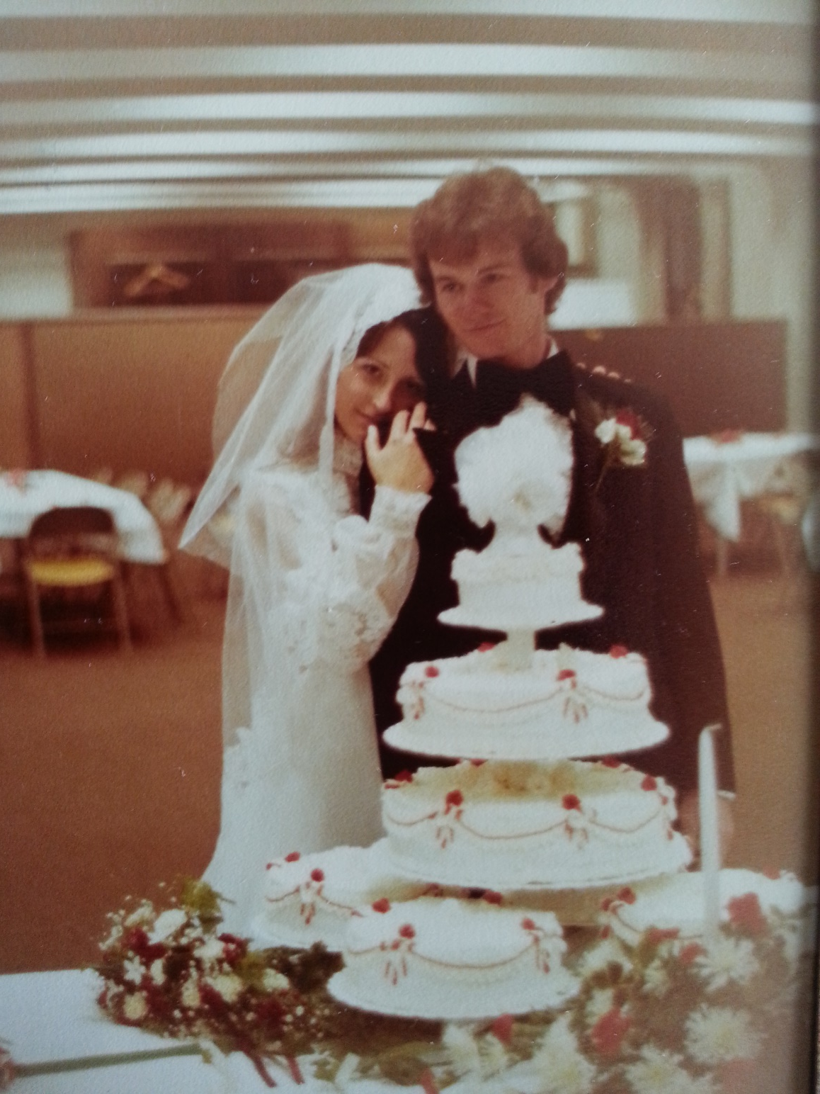

Slide 4
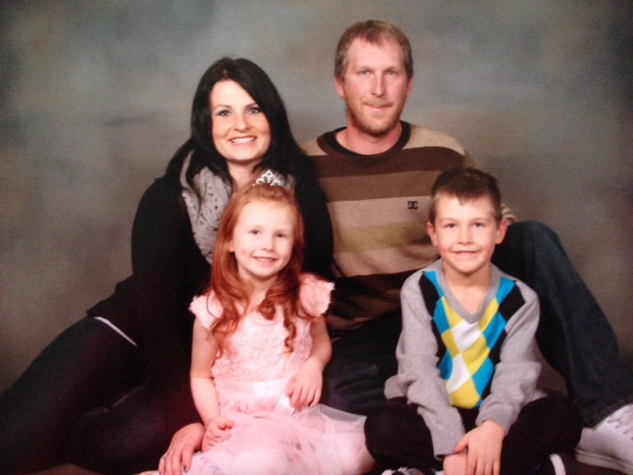
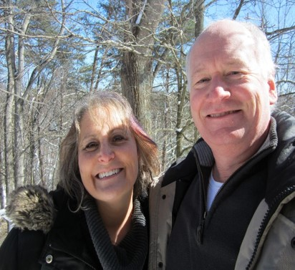
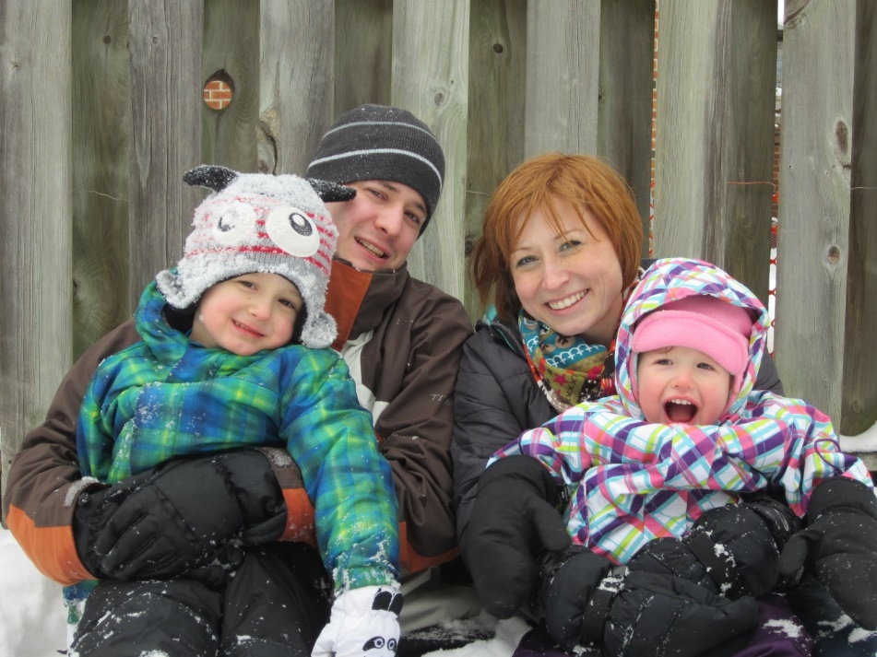

Slide 5
In the Beginning

Slide 6
In the Beginning
Then the Lord God said, “It is not good for the man to be alone. I will make a helper who is just right for him.” ……………. ²¹ So the Lord God caused the man to fall into a deep sleep. While the man slept, the Lord God took out one of the man’s ribs and closed up the opening. ²² Then the Lord God made a woman from the rib, and he brought her to the man.
- Companionship
- Helper

Slide 7
²³ “At last!” the man exclaimed.
“This one is bone from my bone, and flesh from my flesh! She will be called ‘woman,’ because she was taken from ‘man.’”
²⁴ This explains why a man leaves his father and mother and is joined to his wife, and the two are united into one.
²⁵ Now the man and his wife were both naked, but they felt no shame.
In the Beginning
Unity
Oneness

Slide 8
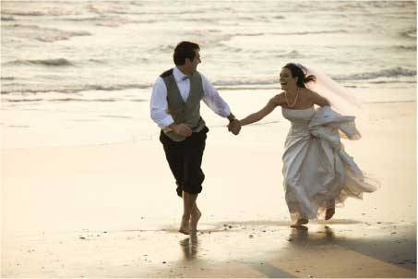
A newly married man must not be drafted into the army or be given any other official responsibilities. He must be free to spend one year at home, bringing happiness to the wife he has married. Deut. 24:5

Slide 9
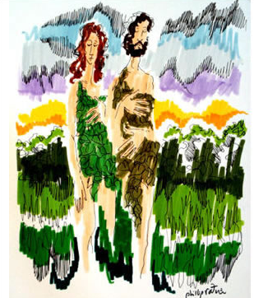
The Problem

Slide 10
The Problem
⁷ At that moment their eyes were opened, and they suddenly felt shame at their nakedness…..

Slide 11
The Problem
⁷ At that moment their eyes were opened, and they suddenly felt shame at their nakedness…..
¹² The man replied, “It was the woman you gave me who gave me the fruit, and I ate it.”……..

Slide 12
The Problem
⁷ At that moment their eyes were opened, and they suddenly felt shame at their nakedness…..
¹² The man replied, “It was the woman you gave me who gave me the fruit, and I ate it.”……..
And you will desire to control your husband, but he will rule over you.”

Slide 13
The Problem
¹⁷ And to the man he said…… the ground is cursed because of you. All your life you will struggle to scratch a living from it……… ¹⁹ By the sweat of your brow will you have food to eat until you return to the ground from which you were made. For you were made from dust, and to dust you will return.”

Slide 14
The Problem
We both sin
For all have sinned and fall short of the glory of God. Romans 3:23

Slide 15
The Solution

Slide 16
The Solution
Though one may be overpowered, two can defend themselves. A cord of three strands is not quickly broken.
Ecclesiastes 4:12

Slide 17
Becoming more
like Jesus

Slide 18
Becoming more like Jesus
³ Don’t be selfish; don’t try to impress others. Be humble, thinking of others as better than yourselves. ⁴ Don’t look out only for your own interests, but take an interest in others, too.
⁵ You must have the same attitude that Christ Jesus had.
Humility Phil. 2:3-8

Slide 19
Becoming more like Jesus
⁶ Though he was God, he did not think of equality with God as something to cling to.⁷ Instead, he gave up his divine privileges; he took the humble position of a slave and was born as a human being. When he appeared in human form, ⁸ he humbled himself in obedience to God and died a criminal’s death on a cross.
Humility
Phil. 2:3-8

Slide 20
Becoming more like Jesus
³⁴ “A new command I give you: Love one another. As I have loved you, so you must love one another.” John 13:34
Love
John13:34 Eph. 5:25-33

Slide 21
Becoming more like Jesus
“Romantic love has no elasticity to it. It can never be stretched; it simply shatters. Mature love, the kind demanded of a good marriage, must stretch….”
Gary Thomas
Love
John 13:34 Eph. 5:25-33

Slide 22
Becoming more like Jesus
³⁴ “A new command I give you: Love one another. As I have loved you, so you must love one another.” John 13:34
Love
John13:34 Eph. 5:25-33

Slide 23
Becoming more like Jesus
³⁴ “A new command I give you: Love one another. As I have loved you, so you must love one another.” John 13:34
Love
John13:34 Eph. 5:25-33
Sacrificial

Slide 24
Becoming more like Jesus
³⁴ “A new command I give you: Love one another. As I have loved you, so you must love one another.” John 13:34
Love
John13:34 Eph. 5:25-33
Sacrificial
Holiness/purity

Slide 25
Becoming more like Jesus
³⁴ “A new command I give you: Love one another. As I have loved you, so you must love one another.” John 13:34
Love
John13:34 Eph. 5:25-33
Spouse
becomes all God intends

Slide 26
Living out our calling together
³⁴ “A new command I give you: Love one another. As I have loved you, so you must love one another. ³⁵ By this everyone will know that you are my disciples, if you love one another.”
John 13

Slide 27
Living out our calling together
“The more chaos there is the more people will look for something solid they can depend on. We can point them to the Rock on whom they can build their lives and families.”

